Slide 1

Wireless Settings
SSID: pegstaff
Security mode: WSA-Personal
Password: letmeinplease!

Slide 2
Google Group
http://group.stlalt.net

Slide 3
DYNAMIC LANGUAGE RUNTIME

Slide 4
What is the DLR?
The DLR is a library that depends on the CLR.
It provides a common interface for dynamic language implementations.
It resolves language bindings at run-time.
It compiles dynamic code into IL on the fly, which is then passed to the CLR for execution.

Slide 5
What is the DLR?
Components:
Expressions
Call site caching
Interoperability binders
Dynamic objects
Hosting API
Debugging API

Slide 6
Watch Your Language
Static Languages | Dynamic Languages
Things happen at compile-time | Things happen at run-time
Static typing | Dynamic typing
Early member bindings | Late member bindings (dynamic dispatch)
Variable types cannot change after Declaration | Variable types can change after declaration
A type’s definition cannot change at run-time | A type’s definition can change at run-time

Slide 7
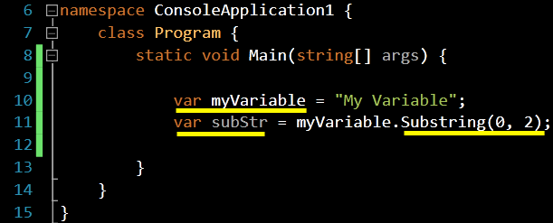
Watch Your Language
Ultimately, objects and calls to their members must be resolved to types. This is called “binding”.

Slide 8
Watch Your Language
Static Binding | Dynamic Binding
Compiler resolves calls to an object’s members at compile-time if the type of the object is known | Calls to an object’s members are resolved at run-time, when the type of the object is known
Member calls are resolved at compile- time | Member calls are resolved at run-time
The process of resolving methods is known as “method binding” or “method dispatch”.

Slide 9
Massive Dynamic
The dynamic keyword in C# allows the programmer to reference objects:
whose types will be discovered at run-time
whose member calls (properties, methods, indexes) will be resolved at run-time
whose usage will not be checked at compile-time by the CLR

Slide 10
Massive Dynamic
What dynamic is not:
var keyword – (C#) implicit typing, happens at compile-time
let keyword – (F#) implicit typing, happens at compile-time
anonymous type – (C#) type is determined at compile-time, but not reusable in code
There are two ways to use the dynamic keyword:
in reference to a true dynamic object
in reference to a static-typed object that will be wrapped with a true dynamic object

Slide 11

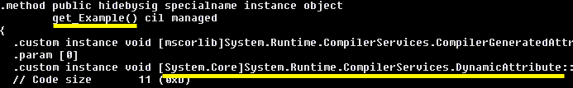
Massive Dynamic
A dynamic reference may point to objects of any type, except for pointers.
Dynamic objects are viewed by the compiler as objects of type Object.
If an object member’s type is dynamic, the compiler annotates the member with a DynamicAttribute and converts the return type to Object.

Slide 12
Massive Dynamic
Expressions that use dynamic objects typically yield dynamic results.
Some member methods on objects may not be called dynamically:
extension methods
interface members
base members hidden by a subclass
This is because the dynamic method resolution process only knows two things:
the name of the method to call
an object on which to call the method

Slide 13
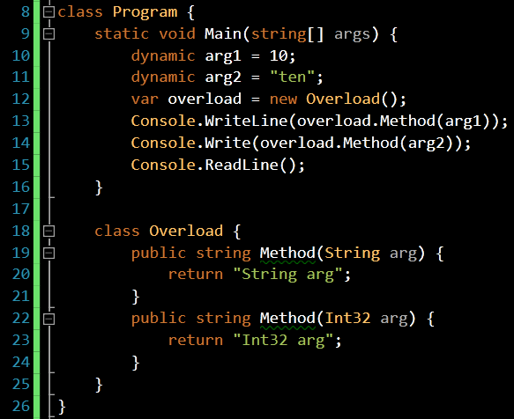
Massive Dynamic
Methods that have static- typed parameters may receive dynamic values
Run-time method resolution will determine if a method overload is invoked or not
Casting an argument to dynamic forces method resolution to be delayed until run-time

Slide 14
CALL SITES
Call sites are locations in code where late binding will occur.
When the CLR encounters a dynamic operation, it emits an instance of CallSite<T>.
Each CallSite uses a binder object to handle the specific dynamic operation.

Slide 15
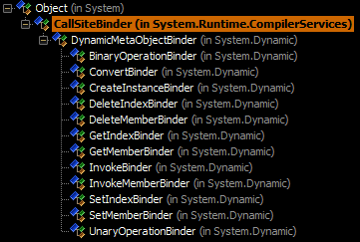
CALL SITES
There are twelve common actions that the DLR defines as common to all languages. Together, these twelve actions for the Common Type System or CTS.
There is a binder that inherits from CallSiteBinder for each of the twelve actions.

Slide 16
CALL SITES
Action | Note
GetMember | Object property access
SetMember | Object property access
DeleteMember | Removes object property (no equiv. in C#)
Invoke | Late-bound call to an entity such as a delegate or function
BinaryOperation | Operation on two operands (add, sub, etc.)
UnaryOperation | Operation on single operand (!, ++, etc.)
GetIndex | Collection index access
SetIndex | Collection index access
DeleteIndex | Removes an element and index in a collection (no C# equiv.)
CreateInstance | Late-bound instance creation (“new” keyword is only compile-time)
Convert | Late-bound casting

Slide 17
CALL SITES
The “Target” property on a CallSite instance is a delegate that will be executed at run-time. The delegate accepts several parameters:
the CallSite<T> instance (required first parameter)
input arguments (e.g., in the case of a binary operation, there would be two operands)
The target delegate must also declare a return type.

Slide 18
CALL SITES
The CallSiteBinder.Bind() method is invoked to perform the binding operation. It takes several key arguments:
an array of input values
a collection of ParameterExpression objects which represent the meta-data (such as the Types) of each input value
a LabelTarget instance which represents a “return point” in code where the dynamic evaluation started
CallSiteBinders generate DLR expressions that represent the result of the binding process.

Slide 19
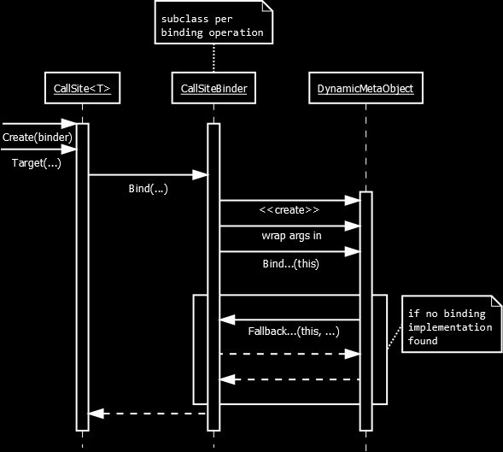

Slide 20
CALL SITES
CallSites cache the result of a binding process.
There are three levels of binding cache:
L0 – the target delegate’s cache
L1 – the CallSite’s cache
L2 – the CallSiteBinder’s cache
CallSites do not share cache, but if they share a binder, the binder’s cache is effectively shared.

Slide 21
EXPRESSIONS
DLR Expressions:
are a superset of LINQ expressions
represent operations in code, in an abstract format (“code as data”)
can be mapped to other language syntaxes (Ruby, Python)
generate concrete language syntaxes when serialized
always return a value (there are no statements)
all derive from System.Linq.Expressions.Expression
are used by CallSiteBinder and DynamicMetaObject instances to expression the syntax flow of binding operations

Slide 22
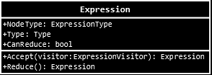
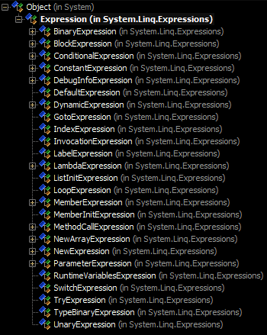
NodeType – the type of the operation being performed (e.g., Addition, Division, Convert, New, etc.)
Type – the .NET type that the expression will yield if executed

Slide 23
EXPRESSIONS
The Expression base class has many helper methods to create instances of particular expression objects:
Expression.IfThen()
Expression.IfThenElse()
Expression.Add()
Expression.Subtract()
Expression.Switch()
Expression.ArrayAccess()
etc.

Slide 24
EXPRESSIONS
Custom expression classes may be created to describe operations at a higher (more coarse) level of abstraction that DLR expression types.
Reduction is the process of breaking down higher level expressions into lower-level, DLR defined expressions.
The Expression.CanReduce and Expression.Reduce() members are used for this purpose.
Custom expressions must override the NodeType property and return ExpressionType.Extension, which indicates to binders that it is a non-DLR defined expression.

Slide 25
Custom Dynamic Objects
Dynamic objects are objects that know how to perform their own late binding.
Dynamic objects must implement IDynamicMetaObjectProvider, and optionally, may simply inherit from DynamicObject.
Each dynamic object is associated with a DynamicMetaObject instance, which provides the actual binding functionality for the dynamic object instance.
If Bind…() methods are not implemented in the DynamicMetaObject, the binder fallback implementations are used for each given operation.

Slide 26
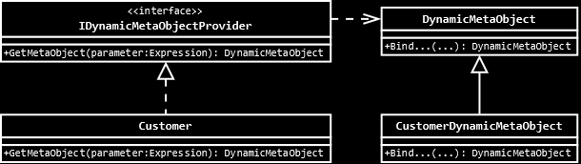
Custom Dynamic Objects

Slide 27
Custom Dynamic Objects
If a dynamic object inherits from the DynamicObject base class, it inherits members that correspond to each binding operation, but that do not leverage expression trees – simple C# code may be used.
If the dynamic object instance inherits from DynamicObject and does not implement one of the Try…() methods, the default binder fallback implementations are used for each given operation.

Slide 28
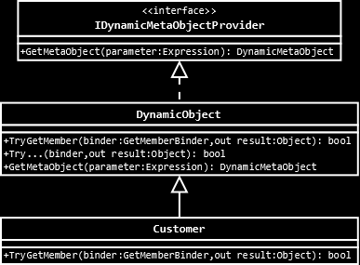
Custom Dynamic Objects

Slide 29
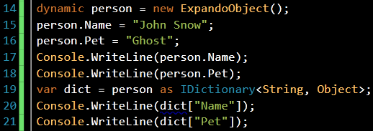
Expando Objects
The ExpandoObject class is a special dynamic object that implements:
IDynamicMetaObjectProvider
IDictionary<String, Object>
Under the hood, property get/set operations are performed against the dictionary.

Slide 30
Language Interop
DLR expressions, the DLR Common Type System, and the DLR hosting API make it possible for different languages to interoperate at runtime.
Current DLR language implementations:
IronRuby -- http://www.ironruby.net/
IronPython -- http://ironpython.codeplex.com/
IronJS -- https://github.com/fholm/IronJS
Iron* language references can be installed with NuGet.

Slide 31
Language Interop
Objects from one language can be passed to other languages, and will be dealt with according to the rules of those languages.
Each language defines its own binders.
The DLR uses ScriptRuntimes to host script engines, which allows access to classes, functions, and variables in DLR based languages.

Slide 32


Resources
DLR on CodePlex -- http://dlr.codeplex.com/
DLR specs -- http://dlr.codeplex.com/wikipage?title=Docs%20and%20specs
IronPython -- http://ironpython.codeplex.com/
IronRuby -- http://www.ironruby.net/
Pro DLR in .NET 4 by Chaur Wu (Apress)
C# 4.0 in a Nutshell by Joseph and Ben Albahari (O’Reilly)

Slide 33
Resources
“Dynamic in a Static World” by Hadi Hariri -- http://ndc2011.macsimum.no/SAL7/Onsdag/1620-1720.wmv
“IronRuby FTW!!!” by Shay Friedman -- http://ndc2011.macsimum.no/SAL1/Torsdag/0900-1000.wmv

